Slide 1
Segmentation of Brain Tumors from Multiple MRI Sequences
Suzanne Piver and Wisdom Ikezogwo
CSE/ECE 577
Final Project

Slide 2
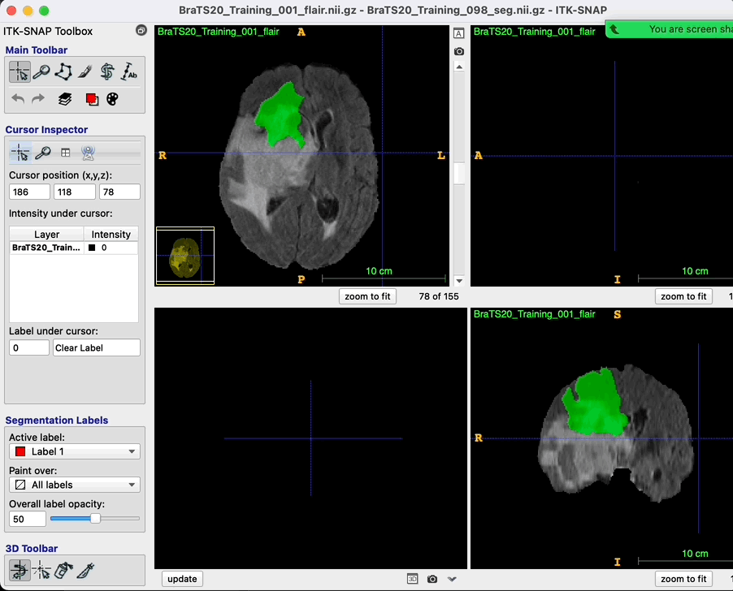
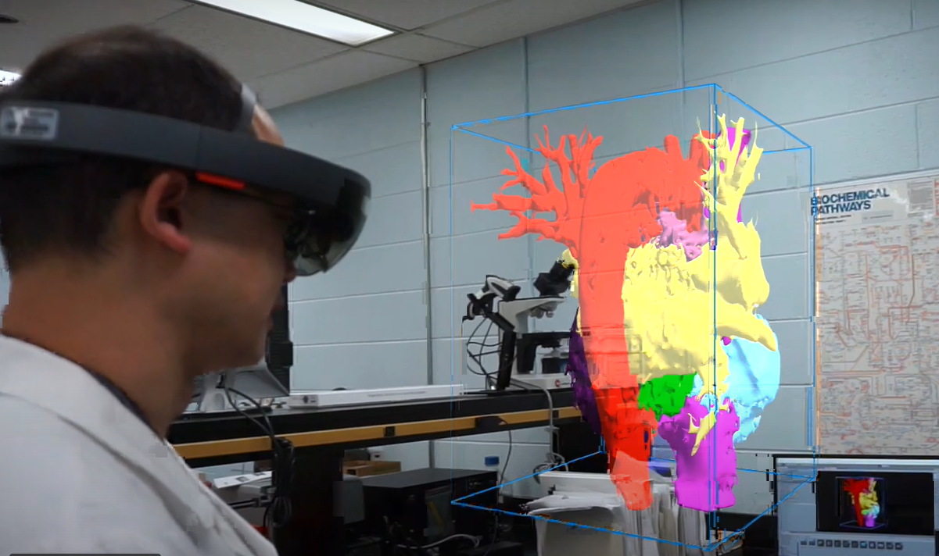
Problem and Solution
Segmentation of Tumors
Aid in diagnosis of cancer
Visualizations
Patient explanations
Surgical Approaches
Machine learning can be used to train a model to automatically segment a brain tumor
RTX 3080 Ti GPU
8GB of memory
https://www.mcvfoundation.org/news/stories/how-augmented-reality-helped-vcu-health-surgeons-save-college-students-life
Notes:
Suz

Slide 3
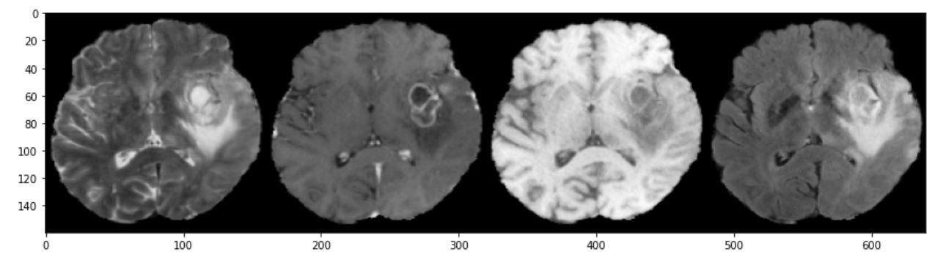
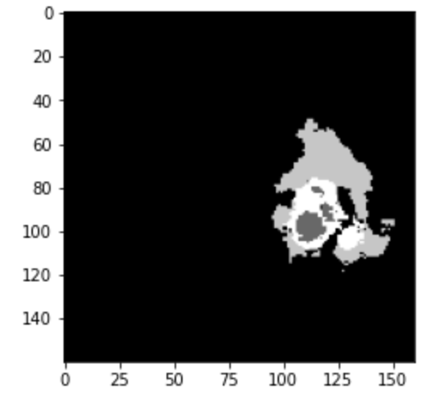
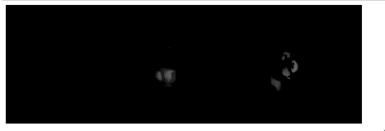
Data
"Multi Modal Brain Tumor Segmentation Challenge (BraTS 2020)"
Sequences
Native T1(T1)
Post-Contrast T1-weighted (T1ce)
T2 fluid attenuated inversion recovery (T2-FLAIR)
T2-weighted (T2)
369 Patients
Notes:
Suz
In order left to right(
T1-3 different views going through the scans
Limitation is scanning techniques are not standardized and not all of these are regularly done for every patient

Slide 4
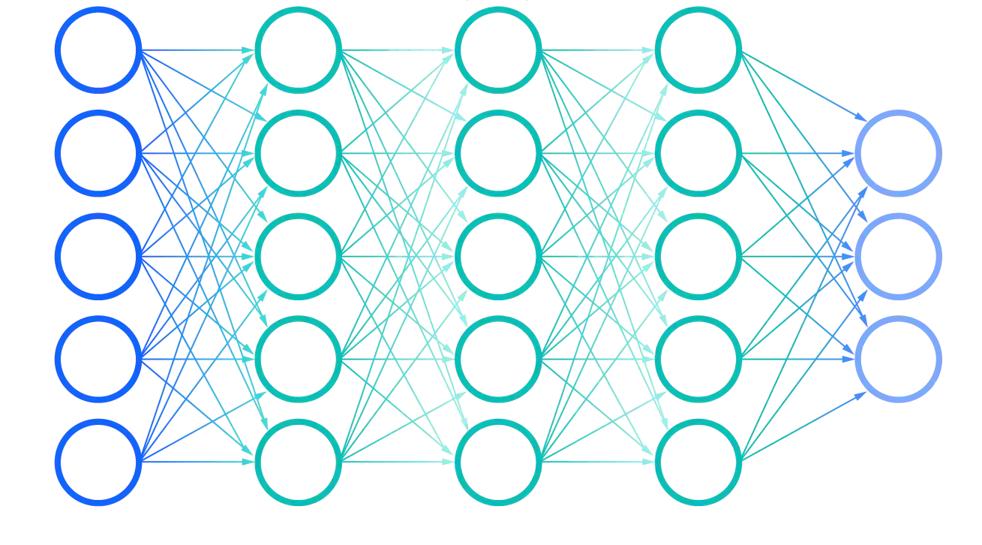
Method
BraTS 2020 Winners
2D U-Net with region based training
Whole Tumor Dice Score: 0.8895
BraTS 2020 top 10
3D U-Net with deep supervision and weight averaging
Whole Tumor Dice Score: 0.885
Our approach:
Data augmentation
Dice score
3D U-Net
Kfold
Visualization
https://www.ibm.com/cloud/learn/neural-networks
Notes:
Wisdom

Slide 5
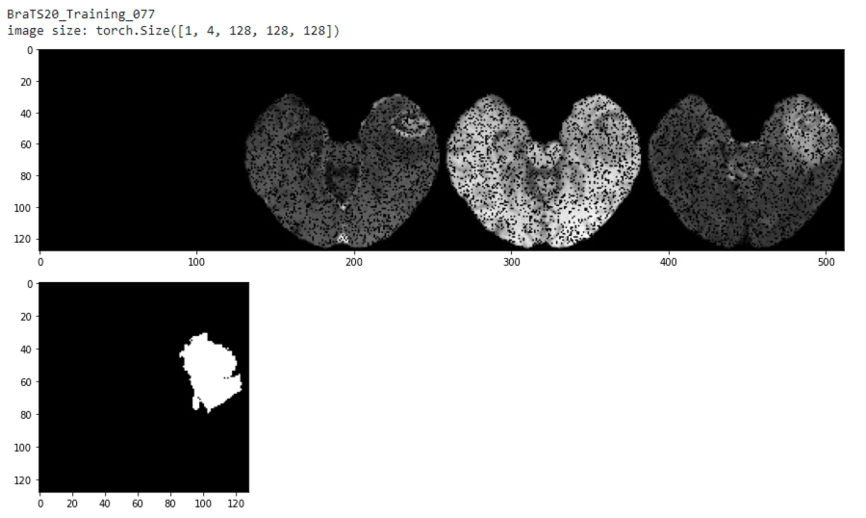
Train Data Augmentation
Min Max Normalization
Rescaling to 128x128x128
ZeroSprinkle
randomly zeros out voxels with a set probability
ZeroChannel
Randomly zeroes out a sequence with a set probability
RandomFlip
Randomly flip image horizontally as well as vertically
Notes:
Wisdom
Augmentations help to make the model more robust for various types of images that could be in the test set
Reduce overfitting
At the edge of the brain

Slide 6
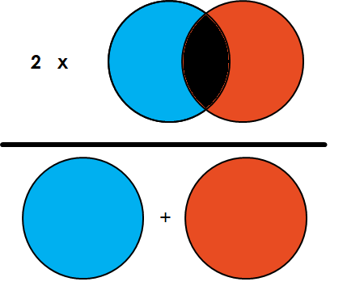
Dice Score
2*Area of Intersection/total number of pixels
Intersection: How many pixels are 1 in the prediction AND the ground truth
Total Pixels: Number of pixels valued 1 in the prediction and the ground truth
This is relative to only the tumor
Background pixel are 0 so they are not considered in the computation of the dice score
https://www.kaggle.com/yerramvarun/understanding-dice-coefficient
Notes:
Suz

Slide 7
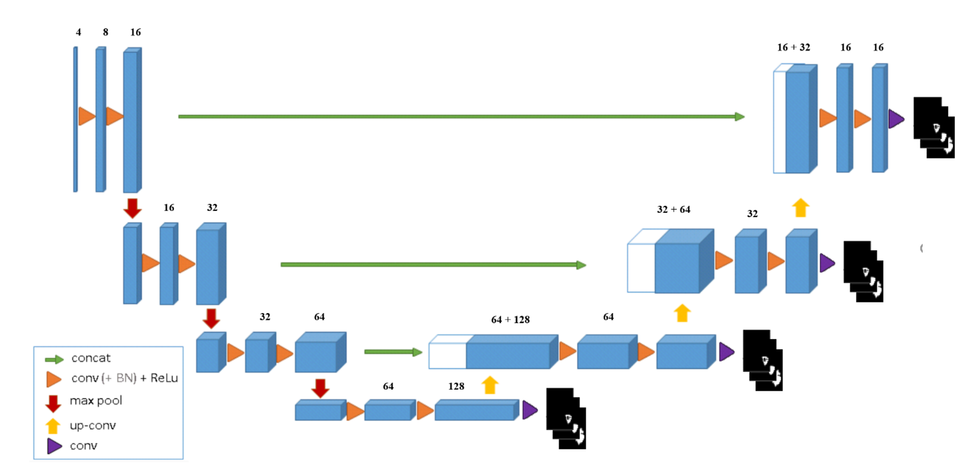
3D U-Net
Block
2 convolutions into a pooling layer
4 in encoder (downsampling)
3 in decoder(upsampling)
Activation
Relu on all convolution
Last layer uses Sigmoid
Optimizer: Adam
Learning Rate Scheduler: OneCycleLR
Loss: Weighted Cross Entropy
Deep supervision: unweighted combination of loss from all 4 levels of network
Notes:
Wisdom
we could have set up a manual lr scheduler, but this would require tuning/cv to set the hyperparams like #by what value to reduce or increase lr and when.
DS we employ to train a deeper model. Not sure on the exact mechanics but my intuition is by getting a sense of what the losses are in the deeper levels we and concatenating with outputlayer we could train models that would learn increasingly reasonable features (deeper).

Slide 8
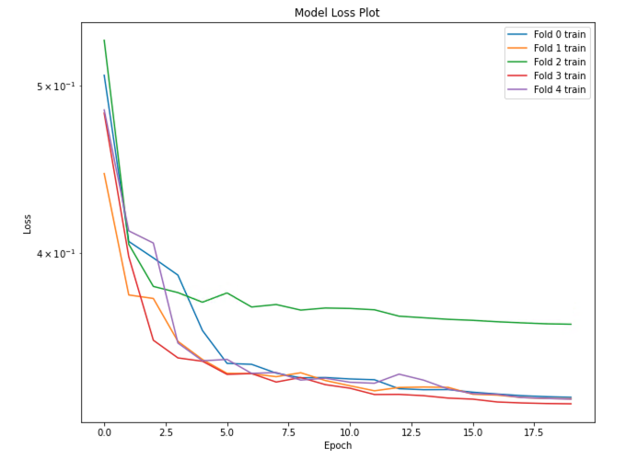
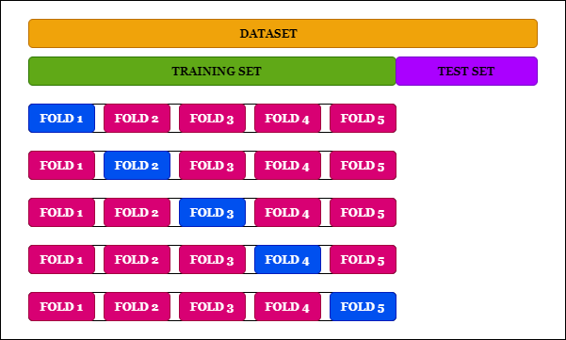
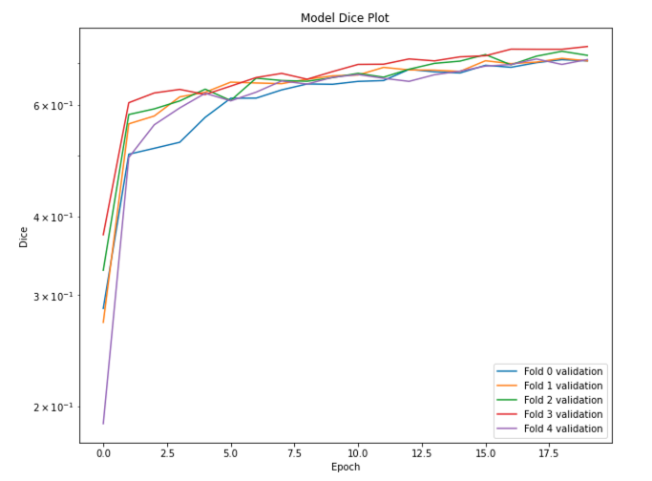
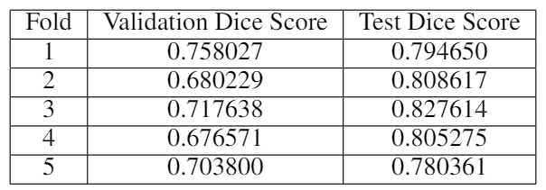
KFold
https://medium.com/the-owl/k-fold-cross-validation-in-keras-3ec4a3a00538
Notes:
Wisdom
Each fold has a unique training and test set resulting in the validation dice score, whereas the test dice score indicates how each model compares in predicting a common set of tumors. We can see that fold 3 performs the best on test set but fold 1 has the best validation score.
We could investigate both of these models weights in future testing.
We see on average across all folds that our model generalizes well, as the numbers on our validation and test dice are very similar.
Due to the small number of epochs used in training and the reasonable results we get, we anticipate that if trained for longer and with more data we could achieve performance close to that of other BraTS competitors.
SOTA is .93

Slide 9
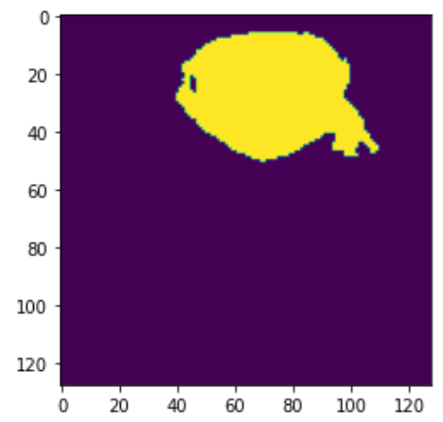
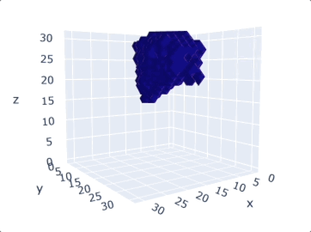
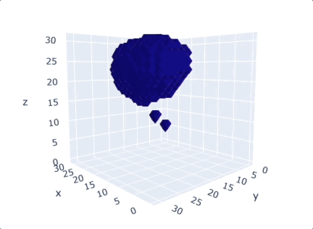
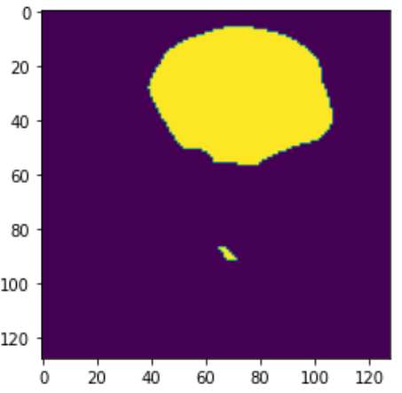
Visualizations
2D
3D
Notes:
Suz

Slide 10
Conclusion
Results
A 3D U-Net model can segment tumors from MRI scans
Kfold illustrates good generalization over the data
More epochs with all the training data using a better machine could provide results similar to other competitors
Next Steps
Initialize models using weights from best folds
Train a model for tumor regions
Train multiple models for each region and use in ensemble format
Notes:
Suz

Slide 11
Questions
suzpiver@uw.edu, wisdomik@uw.edu

Slide 12
Additional Slides

Slide 13
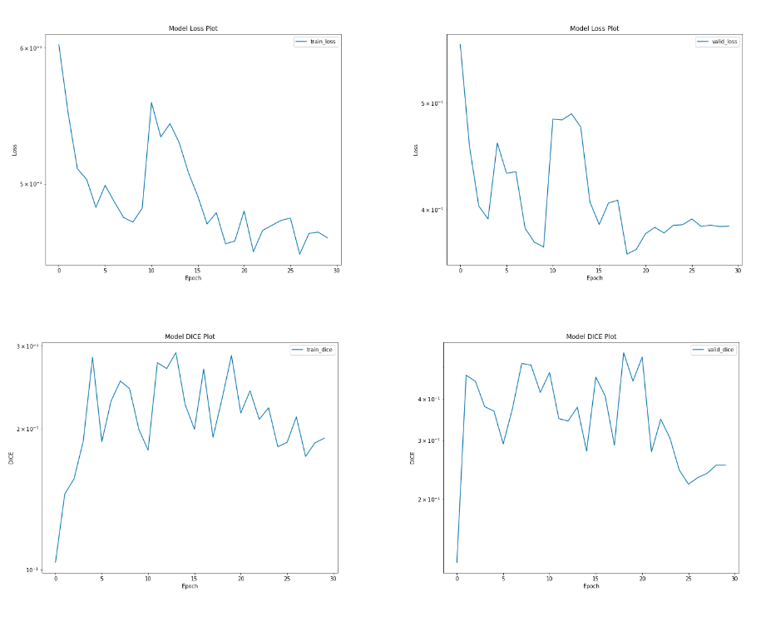
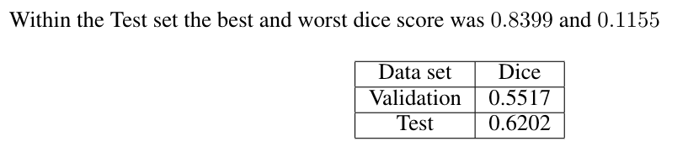
Scratch Model Performance
General trend of decreasing loss
Best model at 19 epochs
Wide range of performance on the test set indicating the train and test data are not representative of each other
Notes:
Wisdom
Here we split our data into 99,36, 38. 173 out of 369 i.e ~0.47 % of the entire dataset.

Slide 14
Conclusion
Results
A 3D U-Net model can segment tumors from MRI scans
Kfold illustrates good generalization over the data
More training time with a better machine could provide results similar to other competitors
Next Steps
Initialize models using weight from best folds
Train a model for tumor regions
Train multiple models for each region and use in ensemble format
Notes:
Suz

